Slide 1
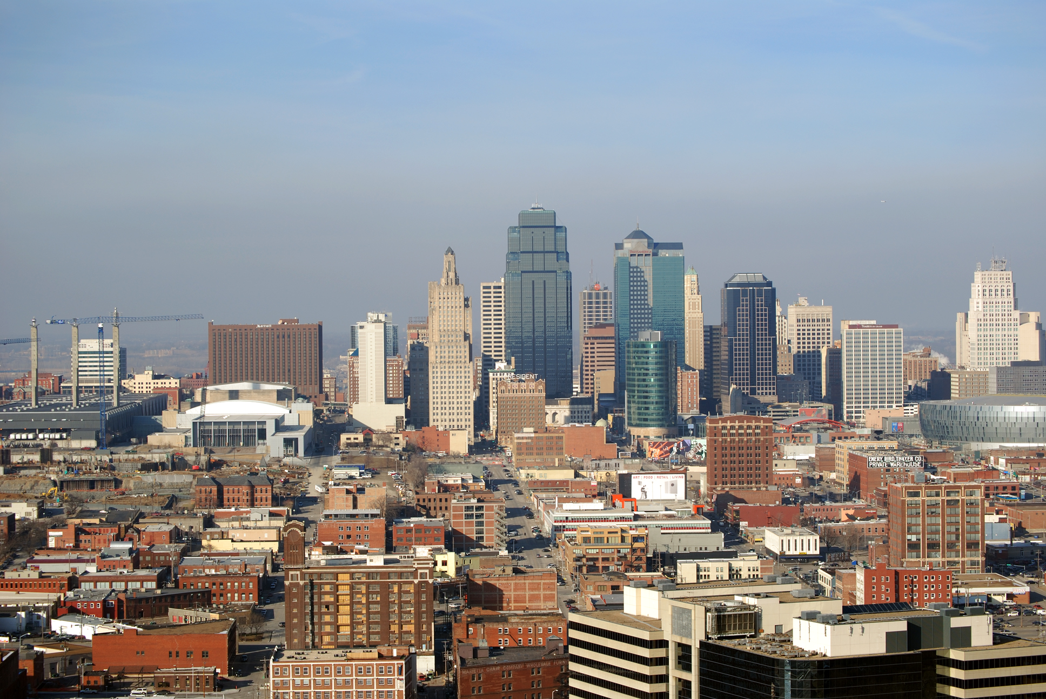

EXPLORATORY DATA ANALYSIS
Crime in Kansas City, MO - 2020
David Hyppolite
Maxwell Sylvestre
Tenzin Jigme
Vagner Maidana

Slide 2
AGENDA
Introduction
Data Overview
Exploratory Data Analysis
Recommendations/Conclusion

Slide 3
INTRODUCTION
Kansas City, Missouri (KC or KCMO) is the largest city in Missouri by population and area.
Kansas City is in the border of Kansas and Missouri but located in Missouri instead.
FOCUS
Crimes in Kansas City during 2020 because that might potentially reveal interesting COVID-19 pandemic insights about crime in a busy city.
COVID-19 crisis in Black and Hispanic communities potentially increased domestic violence and other stress related crimes.
SOFTWARES
Excel and Tableau
clean the data and uncover insights
pivot tables
data visualizations
Notes:
Our team decided to focus on 2020 Kansa City Police Department because of they different cultural background. As Covid 19 increased the numbers of deaths, most of the death was confined to Black and Hispanic ethnic groups. In addition, during the crises, everyone was ordered to isolate at their houses 24/7. This increased domestic violence, child abuse, and other stress related crimes. This was compounded by the fact that lower income jobs were unable to transition to working from home like white privilege jobs.

Slide 4
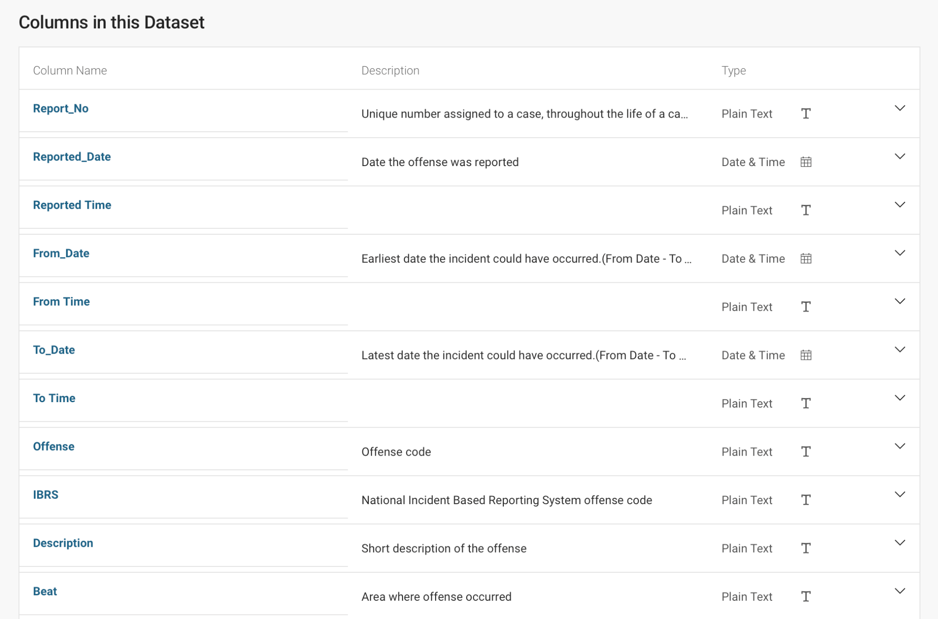
DATA OVERVIEW
Source: Kansas City Police Department - OpenDataKC
Crime Reports from Jan 1st, 2020 to Dec 27th, 2020
within Kansas City, Missouri.
96,220 Rows
23 Columns
Data Types: Text/String, Date/Time, Number, and Geolocation.
Link: KCPD 2020 Crime Reports | Open Data KC

Slide 5
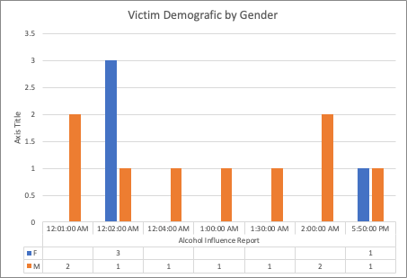
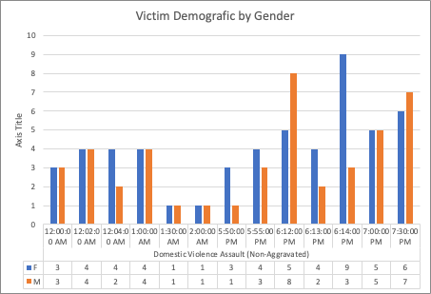
BAR GRAPH OF DOMESTIC VIOLENCE (DV) BY GENDER
Relation between Male and Female victims of domestic violence. It was influenced by alcohol during the period between 12 am to 2 am and between 5:50 pm to 7:30 pm.
“ The description of offense collected by National Incident Based Report System offense (IBRS)”

Slide 6
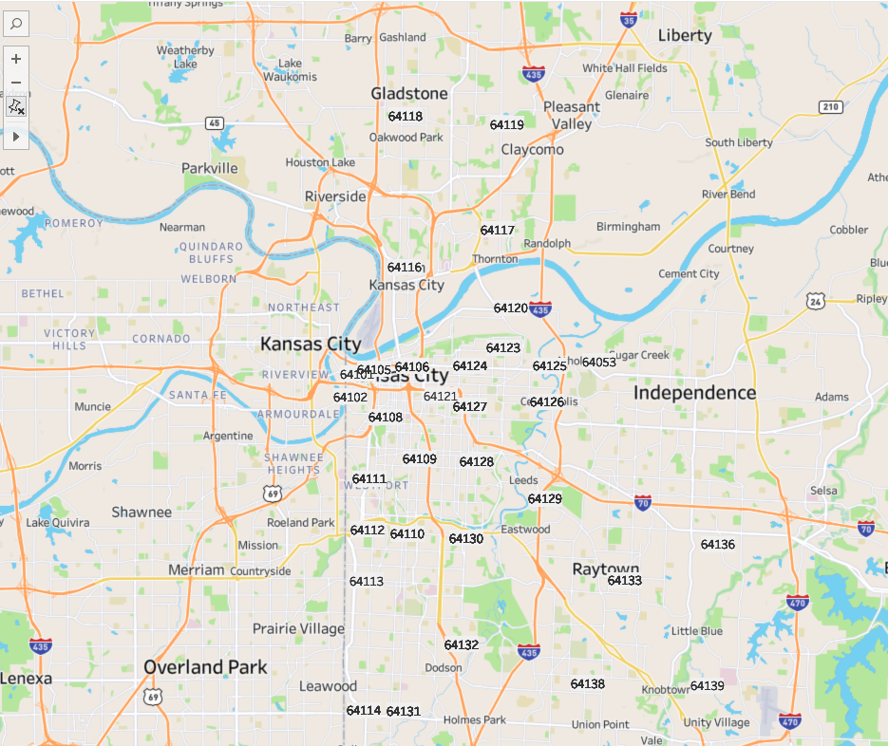
MAP - VICTIMS OF DV
Satellite Map, showing location where the offense occurred.
The zip code allowed Kansas City police to determine how far and how
long take to get to the location where the offense was taken.
“ The description of offense collected by National Incident Based Report System offense (IBRS)”

Slide 7
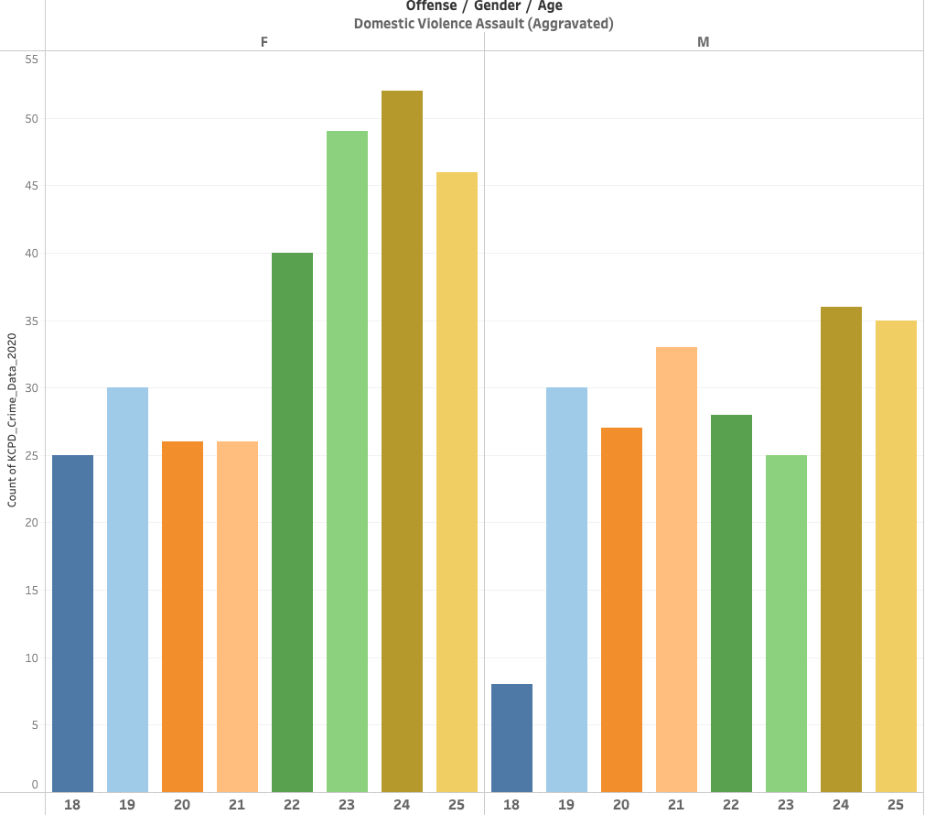
BAR GRAPH DV BY GENDER AND AGE
Domestic Violence aggravated by Gender
group age between 18 and 25
“ The description of offense collected by National Incident Based Report System offense (IBRS”

Slide 8
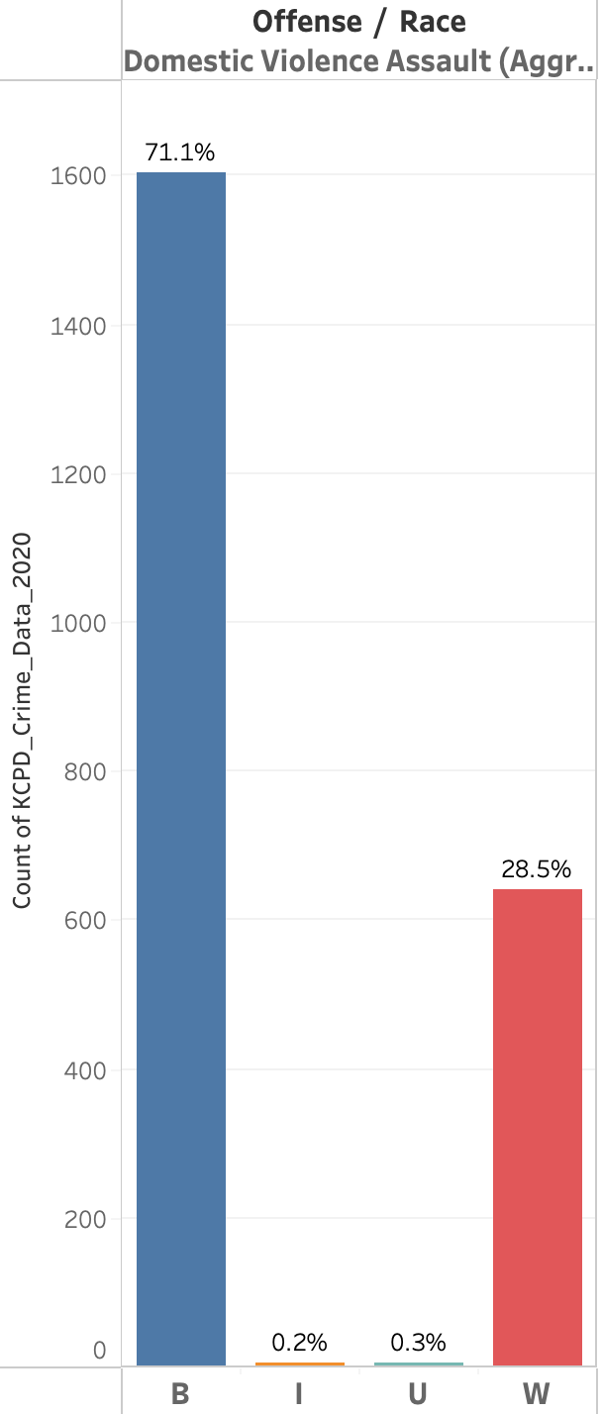
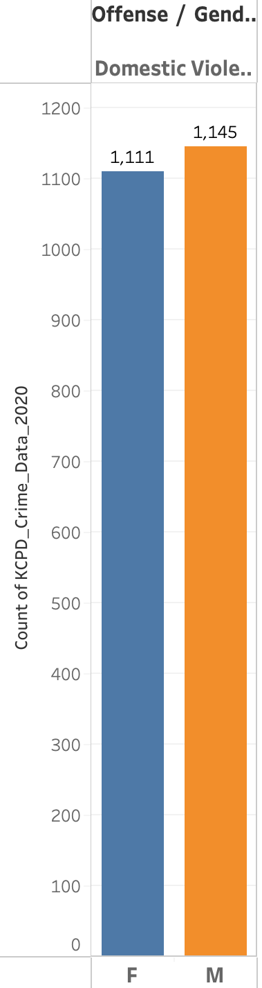
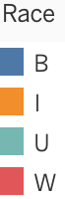
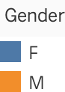
BAR GRAPH - DV BY GENDER, RACE
Domestic Violence aggravated by Race and Gender
group age between 18 and 25
“ The description of offense collected by National Incident Based Report System offense (IBRS”

Slide 9
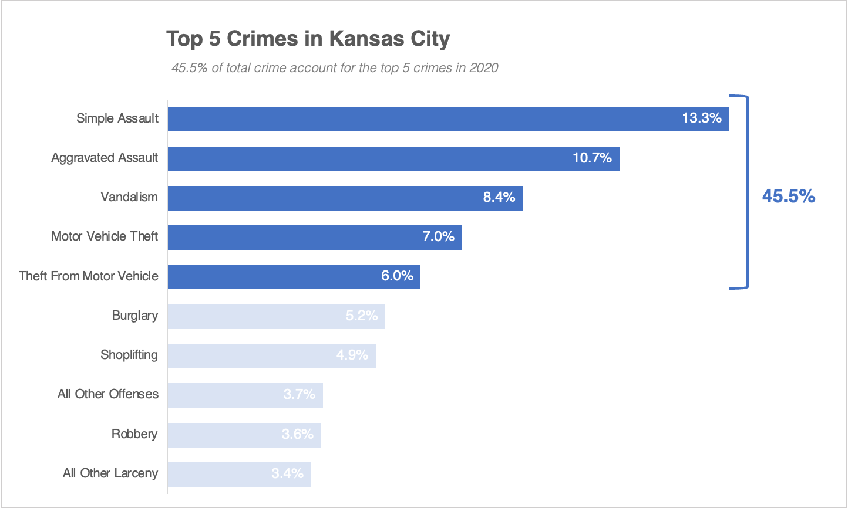
CRIME TYPES
Simple Assault
an act intended to arouse fear in a victim,
but doesn’t have to involve physical contact.
Exploratory Data Analysis on SA

Slide 10
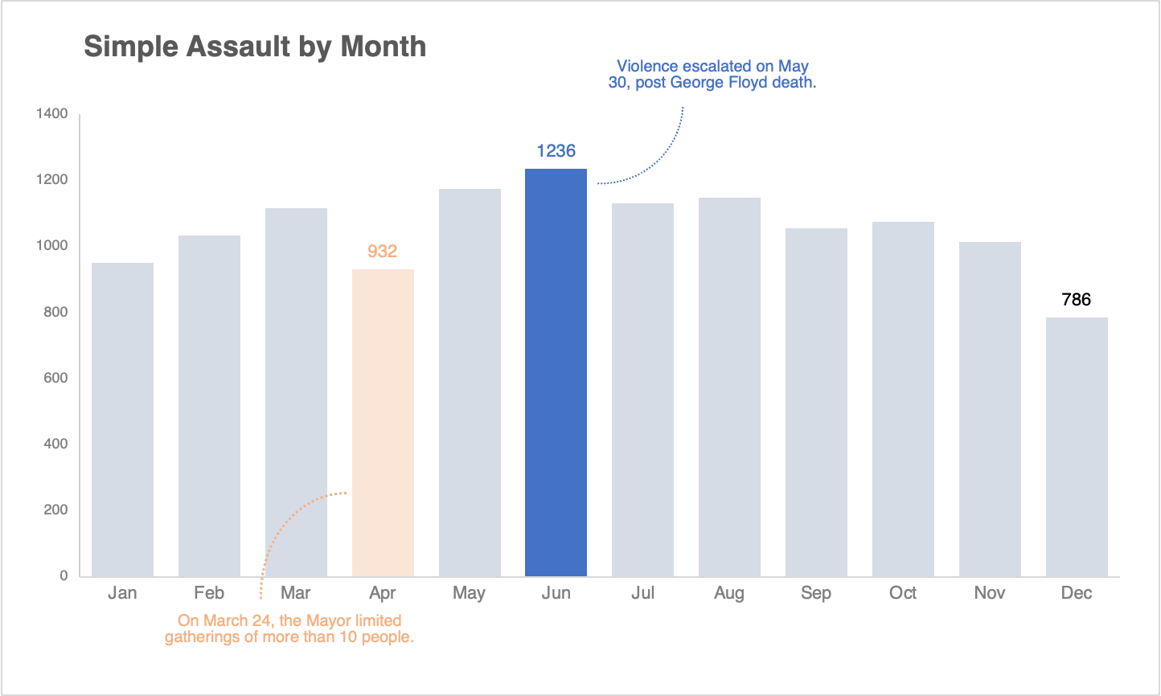
SIMPLE ASSAULT - EDA
Mar 24
Stay at Home Order
May 4
Phase 1, Reopening
May 30
Protest George Floyd
June 8
Phase 3
Notes:
2 major events that accounts for the dip and high.
COVID
George Floyd
breaking into and looting several stores
Verbally threatening
Raising a fist
Multiple KCPD vehicles were damaged, including one that was set on fire. Demonstrators also set a television news station vehicle ablaze.

Slide 11
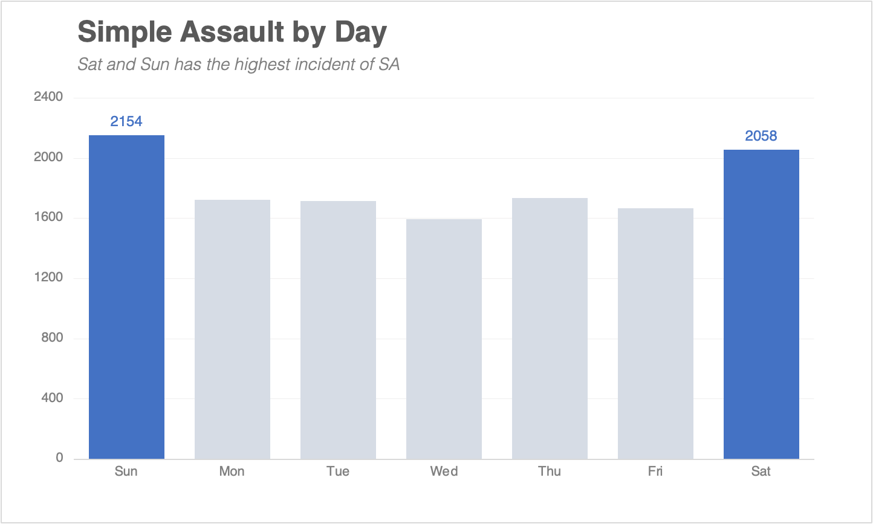
EDA - DAY
SAT & SUN
Highest Incident on the weekends
Notes:
SUN SAT peak
3PM and 10PM conditional formatting Excel
Bar Graph, line graph - Excel

Slide 12
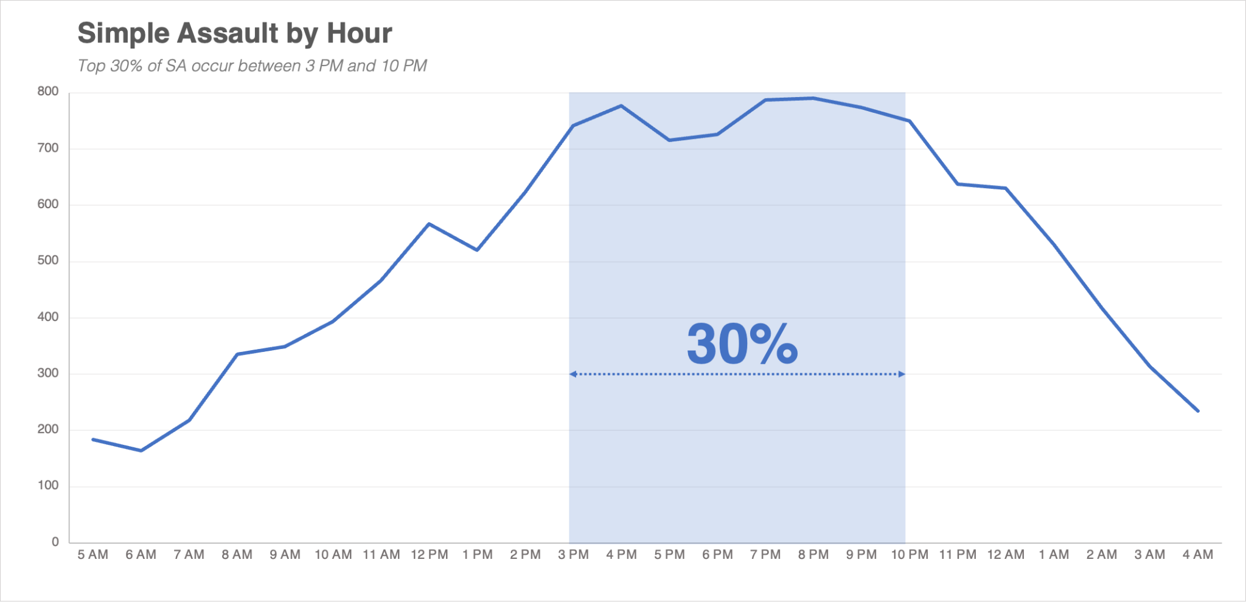
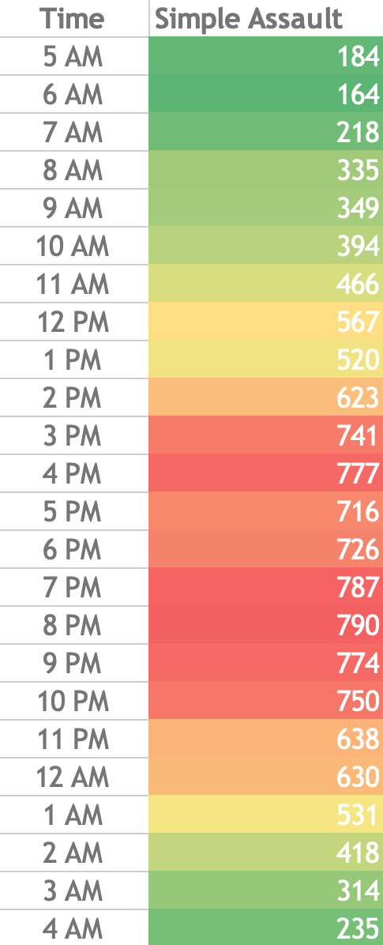
EDA - DAY/HOUR
3PM - 10PM
End of Work
Free Time
Sleep Pattern
Peak Times
Notes:
SUN SAT peak
3PM and 10PM conditional formatting Excel
Bar Graph, line graph - Excel

Slide 13
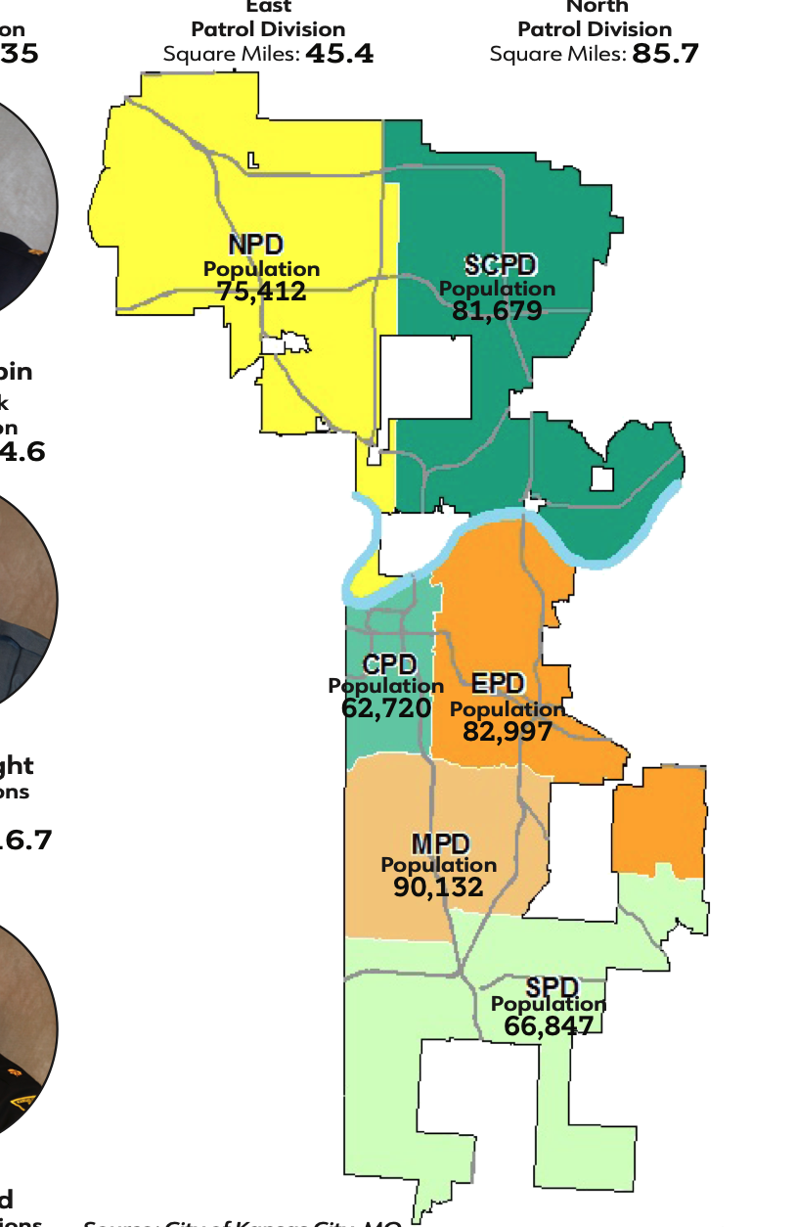
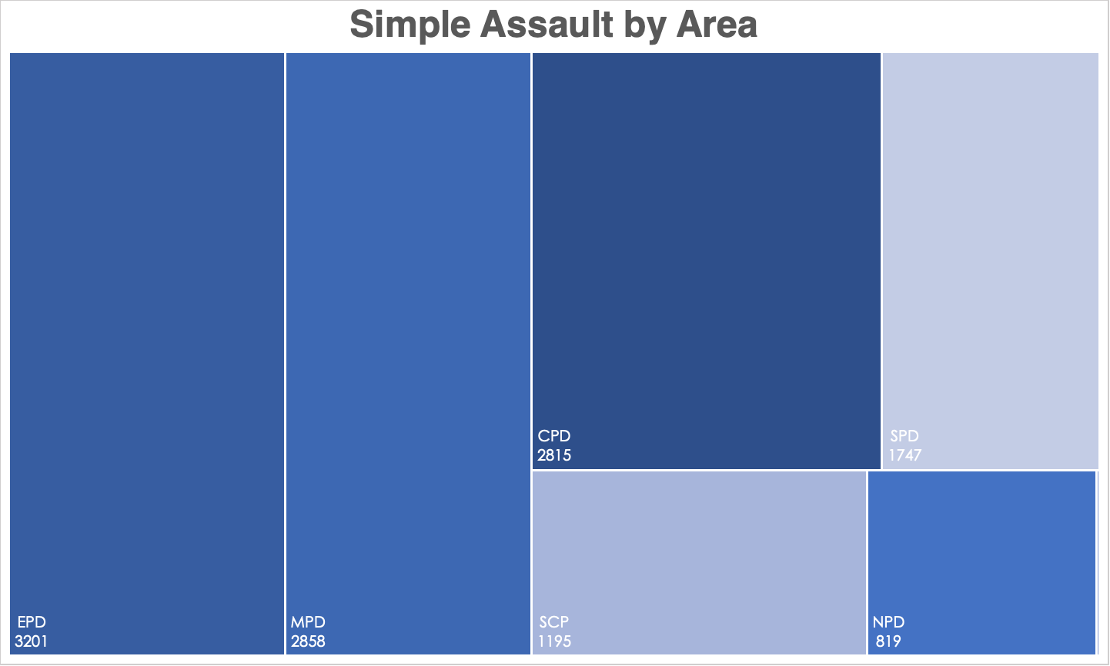
EDA - AREA
Police District (PD)
EPD - East Police District (3201)
MPD - Metro Police District (2858)
CPD - Central Police District
SPD - South Police District
SCPD - Shoal Creek PD
NPD - North Police District
Notes:
EPD
MPD
Treemap - Excel
3201/82997
2858/90132
2815/62720
1195/81679
1747/66847
819/75412

Slide 14
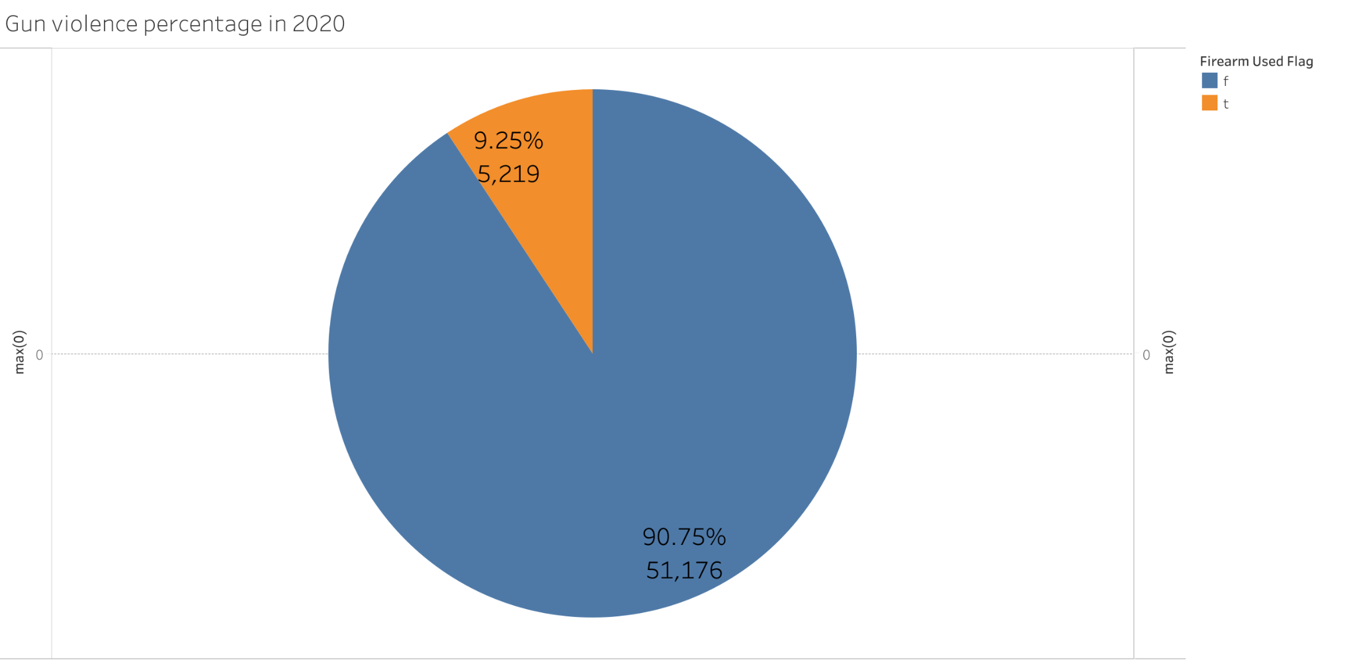
PERCENTAGE OF GUN VIOLENCE

Slide 15
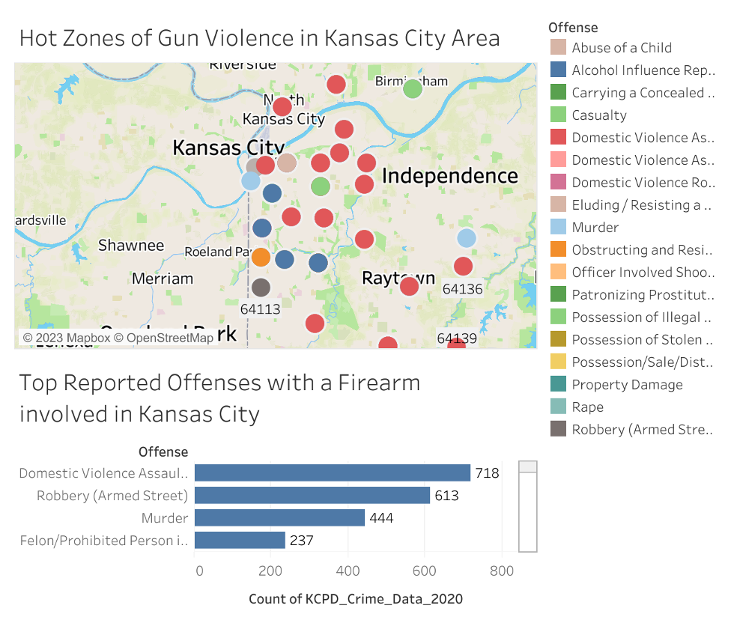
ASSAULT WITH A FIREARM - TYPE & LOCATION
Domestic Violence among the highest in reported offenses with a firearm in 2020

Slide 16
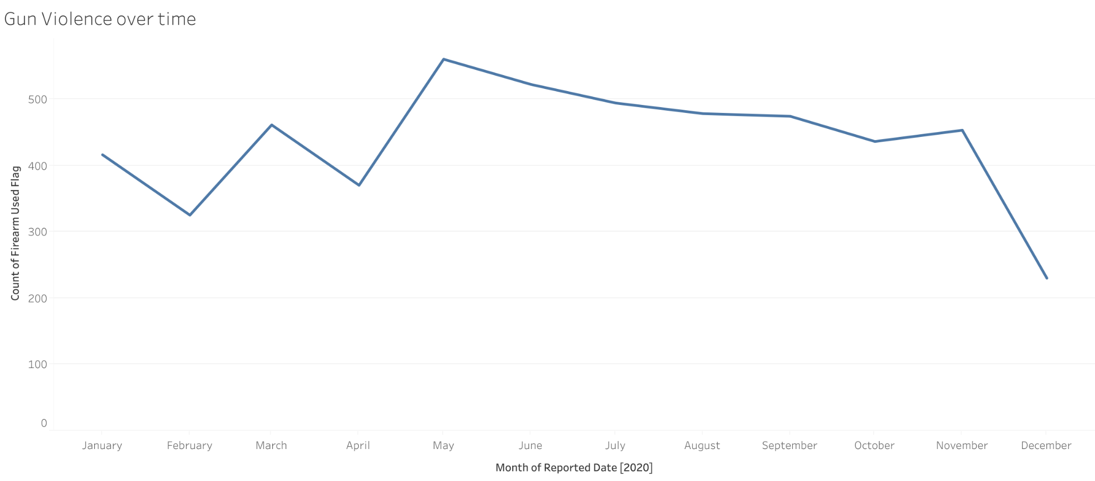
FIREARM USE OVERTIME IN 2020
May recorded the highest count of offenses with a firearm used
December recorded the lowest
Important to note: Lockdown and social distancing mandated March 24th

Slide 17
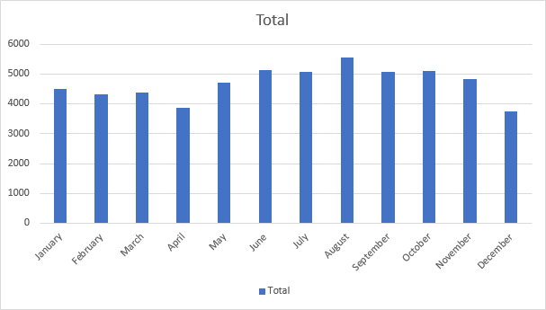
TOTAL CRIME REPORTED IN 2020
This Chart represent the number of crime reported throughout 2020.
August represent the highest count of crime reported.

Slide 18
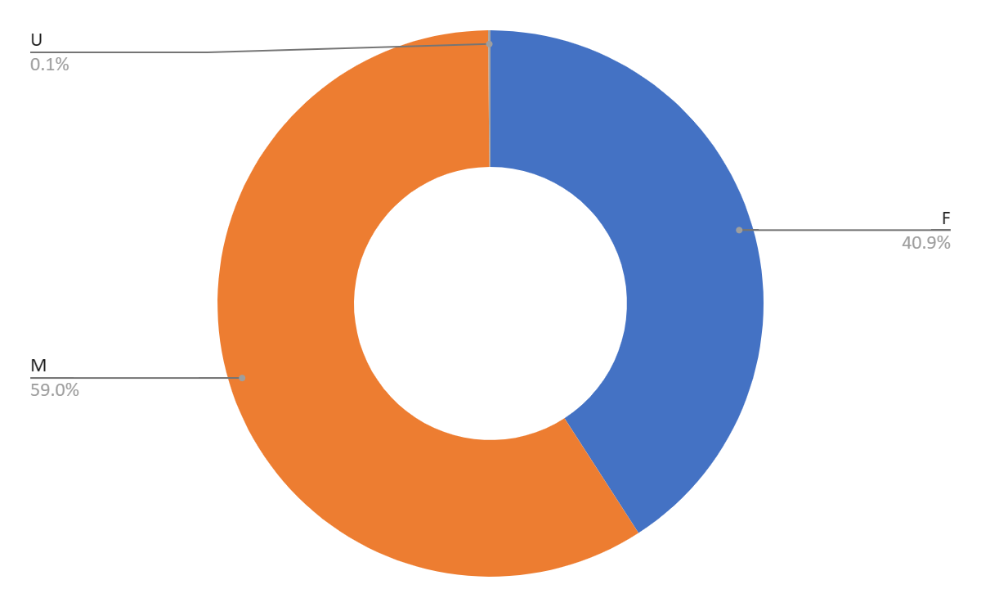
CRIME DEMOGRAPHICS
This Chart represent the percentage of crime reported for men, women and unidentified individuals.

Slide 19
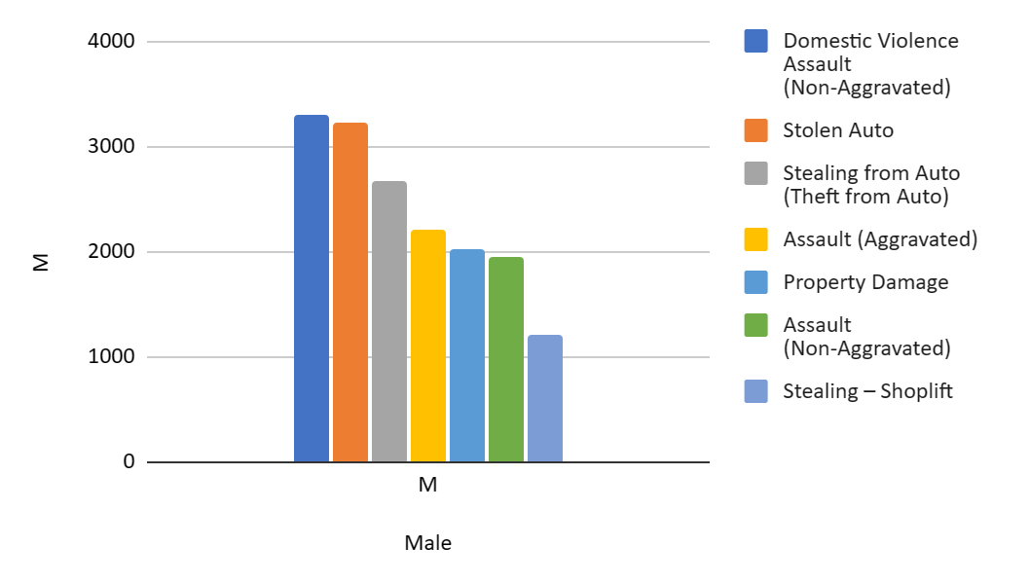
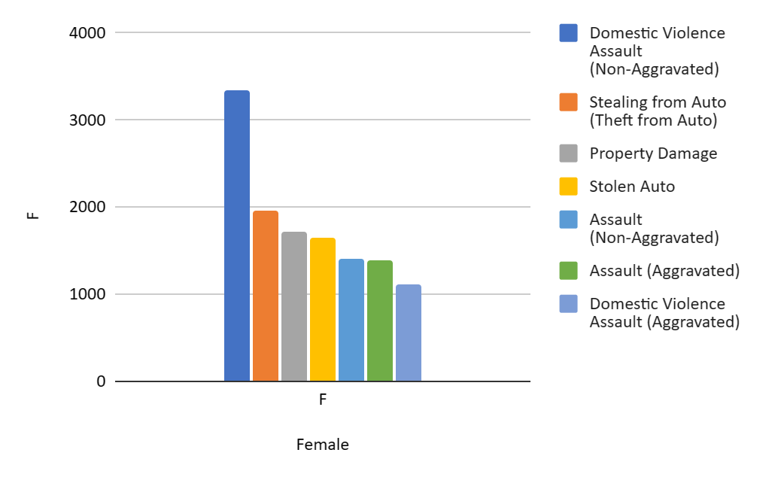
Highest Count of Crime by Gender

Slide 20
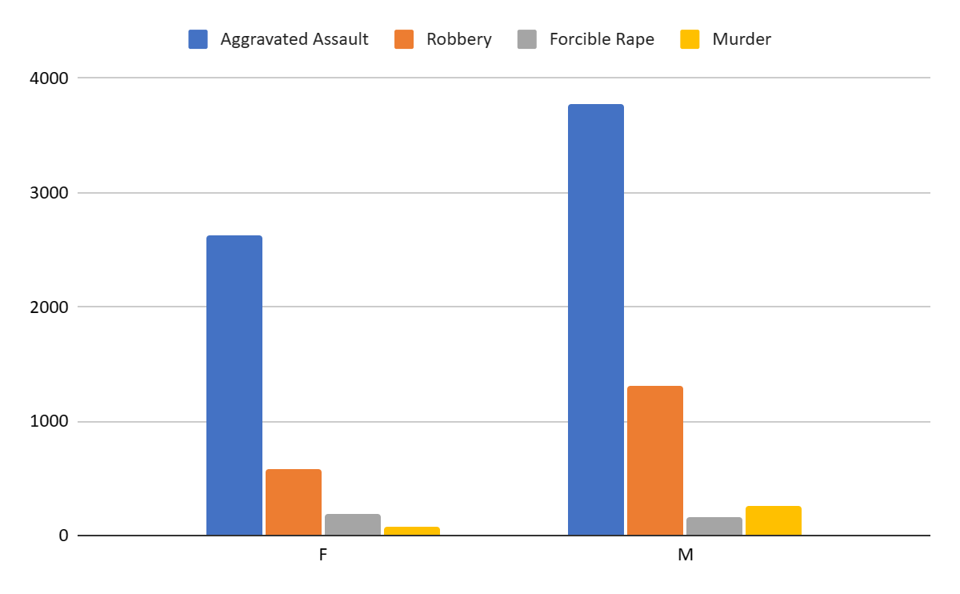
VIOLENT CRIMES
Violent crime reported among male and female in 2020.
June recorded the highest number of violent crimes reported in 2020.

Slide 21
RECOMMENDATIONS / CONCLUSION
1
2
3
2
Given Simple Assault accounts for one of the top crime types, police dept. can prioritize deploying more manpower during Sat. and Sun. between 3PM to 10PM within the confines of EPD and MPD.
Keeping gun violence to a minimum post pandemic must involve more domestic violence intervention and allocating more resources for the average individual.
As Covid 19 increased the numbers of deaths, most of the death was confined to Black and Hispanic ethnic groups. In addition, during the crises, everyone was ordered to isolate at their houses 24/7. This increased domestic violence, child abuse, and other stress related crimes. This was compounded by the fact that lower income jobs were unable to transition to working from home like white privilege jobs.

Slide 22




